Slide 1
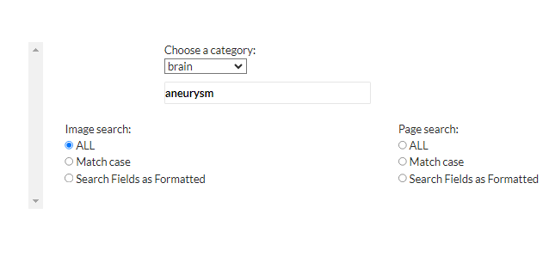

Slide 2
2 results

Slide 4
586 returns 14/586 were brain Why did we miss these? They all had brain in their title and

Slide 6
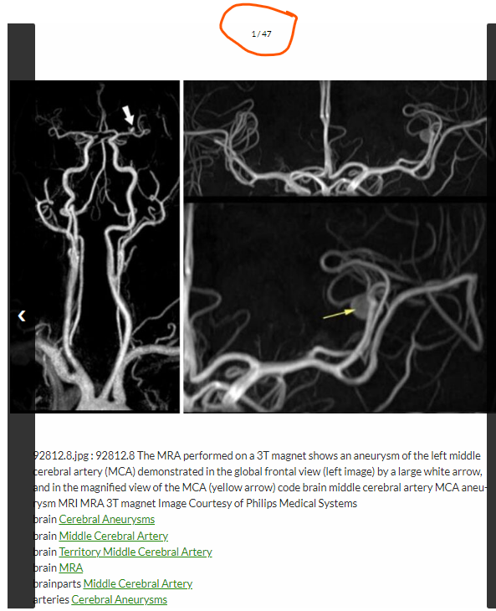

Slide 7
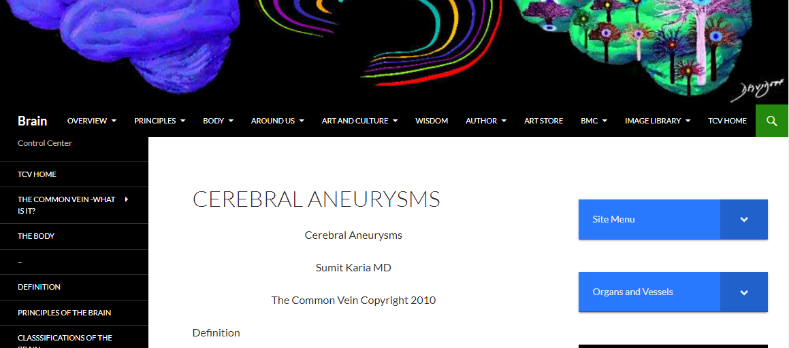
On the brain site there is a whole page dedicated to aneurysms
with 11 images of aneurysms

Slide 9
No Titles

