Slide 1
Problems 9/18
Return of a search shows excessive and irrelevant results
Duplicates Sometimes multiple copies of an image show up
Highlighting inconsistent
Captions not showing up
Images that are in the media file - not found
Links from image to pages not showing up
Pages that are in the database - not found

Slide 2
Problem - Excessive irrelevant returns

Slide 4
I get 4783 returns – Why?

Slide 5
When I search the term “heart aneurysm” I get 108 returns This is more accurate

Slide 6
Why?

Slide 7
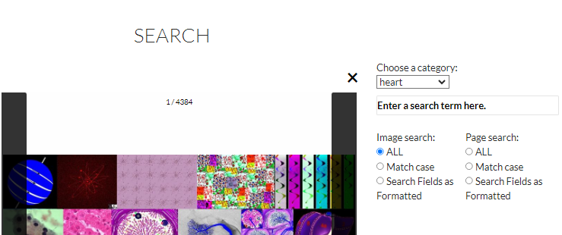
Also note when I only search the category “heart “ I get a lesser number than greater number of returns 4384 vs 4783

Slide 8
Why?

Slide 9
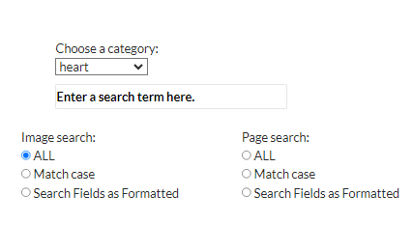
What are we including in the search when we are searching category heart ? 1 – title 2 - caption 3- Page from domain? If 3 is true then we should exclude from now on

Slide 10
Next problem Duplicates triplicates Why?

Slide 11
Problem: Same image coming up multiple times

Slide 13
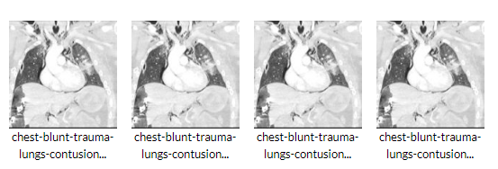
Problem – Why do we have multiple images?
4 images come up

Slide 14
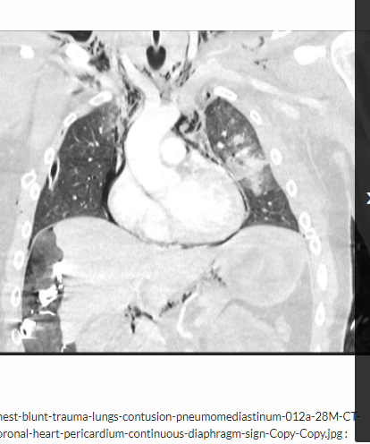
Problem Highlighting Inconsistent/ No Links when there should be links/Captions
Problem 1 Sometimes highlighted
Problem 2 None have links to a page
Problem 3 None have captions
Problem Sometimes not highlighted
And I know this image appears on https://lungs.thecommonvein.net/217lu-pneumomediastinum/ with caption

Slide 15
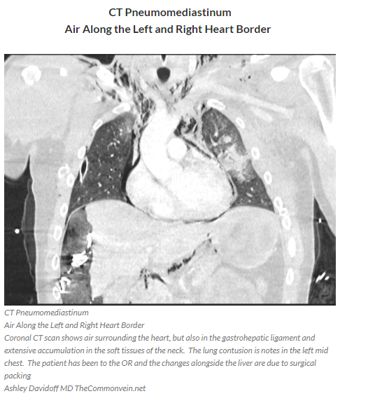
When I go to the non beta site and go to https://lungs.thecommonvein.net/217lu-pneumomediastinum/
Problem
There is a legend and this did not show on the beta site

Slide 16
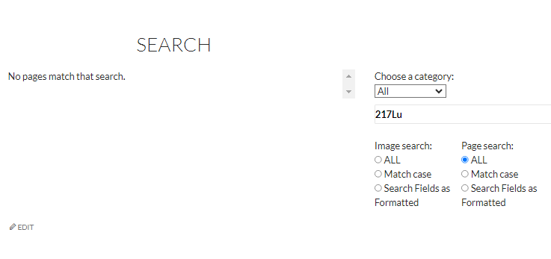
And when I do a pages search for 217Lu on the Beta site I get “No Pages”

Slide 17
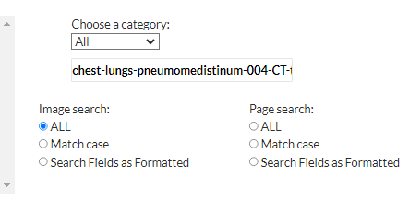
When I search the image name of that image which is chest-lungs-pneumomedistinum-004-CT-trauma on the Beta site

Slide 18
I get highlight but no link to the page but do get a caption

Slide 19
So multiple problems here
Duplicates triplicates
Inconsistent highlighting
Fails to show caption
Fails to show a link to a page
Fails to find a page that exists (217Lu)

Slide 20
Another example duplicate images inconsistent page links

Slide 22
Result – 2 images

Slide 23
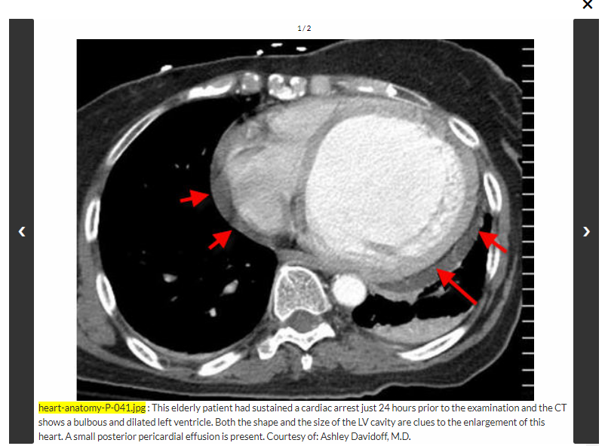
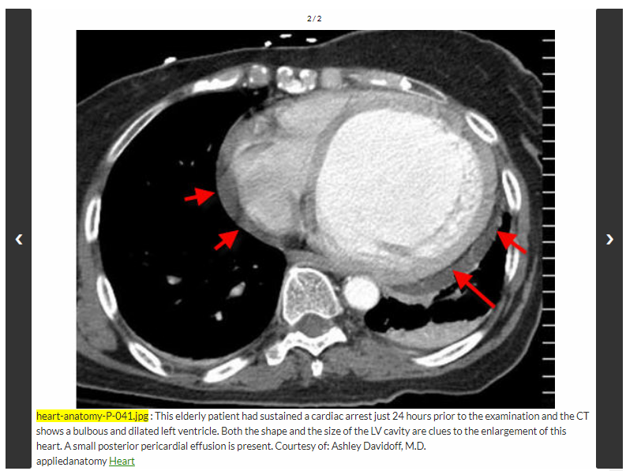
Problem: 1 has a link the other not Why?

Slide 24
Reason?
Could this be because it is showing one from the media file another from the page?

Slide 25
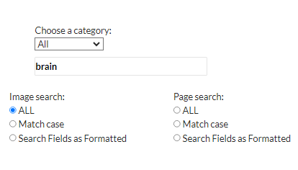
Problem Titles not showing in a image search

Slide 26
Next problem – titles not showing up

Slide 27
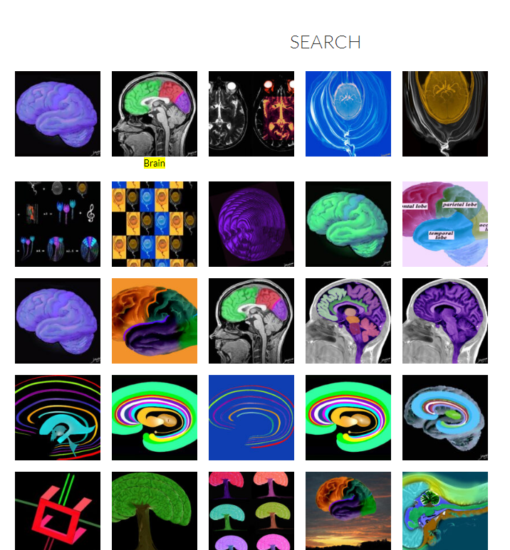
Only one highlighted caption shows

Slide 28
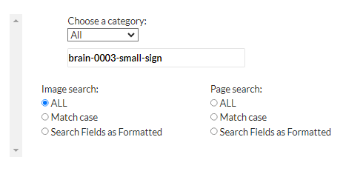
And when I search that image by name

Slide 29
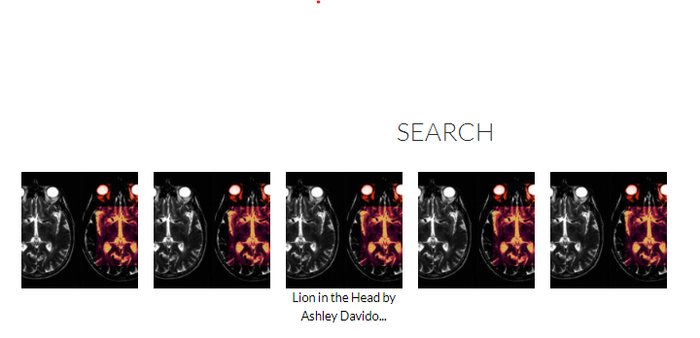
I get 5 examples only 1 has a caption (#3)

Slide 30
Only # 4 of 5 has links

Slide 31
Next Problem - highlighting in text or caption in the Page

Slide 32
Highlight on page links is good

Slide 33
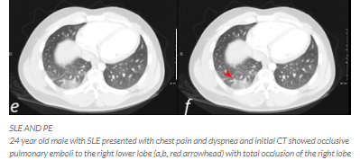
But when you go to the page pulmonary embolism “pulm emb” is not highlighted in the text or caption

